Slide 1
1.3 Embedding Techniques

Slide 2
1.3.1 Latent Semantic Indexing
Vector space retrieval is vague and noisy
Based on index terms
Unrelated documents might be included in the answer set
apple (company) vs. apple (fruit)
Relevant documents that do not contain at least one index term are not retrieved
car vs. automobile
Observation
The user information need is more related to concepts and ideas than to index terms
Notes:
Despite its success and widespread use, the vector space retrieval model suffers from some problems. If the user misses relevant terms in the query, documents that might contain semantically related terms, i.e., terms with the same meaning, will be missed. Also, in the case of terms with multiple meanings irrelevant documents can be returned.
The important insight is that terms may indicate a concept a user is interested in, but there does not necessarily exist a one-to-one correspondence between terms and concepts. As a consequence, retrieval results may contain irrelevant documents, and relevant documents may be missed.

Slide 3
The Problem
Vector Space Retrieval handles poorly the following two situations
1. Synonymy: different terms refer to the same concept, e.g., car and automobile
Result: poor recall
2. Homonymy: the same term may have different meanings, e.g., apple, model, bank
Result: poor precision
Notes:
These problems are related to the fact that the same concepts can be expressed through many different terms (synonyms) and that the same term may have multiple meanings (homonyms). Studies show that different users use the same keywords for expressing the same concepts only 20% of the time.

Slide 4
Example: 3 documents
doc₁
doc₂
doc₃
apple blackberry orange vitamine fruit health tablet
apple blackberry smartphone orange carrier tablet swisscom
iOS iPad RIM mobile handy telcom provider
High similarity
No similarity
Notes:
Let’s illustrate the problem resulting from synonyms and homonyms by an example. Among these three documents at the level of terms doc1 and doc2 are highly related, whereas doc3 has no similarity with the other two documents. Understanding the meaning of the words, it is however easy to see that in reality doc2 and doc3 are closely related, as they talk about mobile communications, whereas doc1 is completely unrelated to the others as it is about health and nutrition.

Slide 5
Key Idea
Map documents and queries into a lower-dimensional space composed of higher-level concepts
Each concept represented by a combination of terms
Fewer concepts than terms
e.g., vehicle = {car, automobile, wheels, auto, sportscar}
Dimensionality reduction
Retrieval (and clustering) in a reduced concept space might be superior to retrieval in the high-dimensional space of index terms
Notes:
Thus, it would be interesting to represent the meaning of documents and queries in information retrieval models on concepts, instead on terms. To that end, it is first necessary to define a "concept space" to which documents and queries are mapped, and compute similarity within that concept space. The concept space should ideally have much lower dimension than the term space, whose dimensionality is determined by the size of the vocabulary.

Slide 6
Using Concepts for Retrieval
d1
d1
t1
t1
d2
c1
d2
t2
t2
d3
c2
d3
t3
t3
d4
d4
Notes:
This figure illustrates the approach: rather than directly relating documents d and terms t, as in vector space retrieval, there exists an intermediate layer of concepts c to which both queries and documents are mapped. The concept space can be of a smaller dimension than the term space. In this small example we can imagine that the terms t1 and t2 are synonyms and thus related to the same concept c1. If now a query t2 is posed, in the standard vector space retrieval model only the document d1 would be returned, as it contains the term t2. By using the intermediate concept layer the query t2 would also return the document d2.

Slide 7
Example: Concept Space
doc₃
doc₂
iOS iPad RIM mobile handy telcom provider
fruit
apple blackberry smartphone orange carrier tablet swisscom
health
device
telco
Notes:
Applying this idea to our example before, we can consider a concept space consisting of four concepts, two related to health, two related to mobile communication. For doc2 and doc3 we recognize much better the close conceptual relationship the two documents have.

Slide 8
Similarity Computation in Concept Space
Concept represented by terms, e.g.
device = {iOS, iPad, RIM, mobile, handy, tablet, apple, blackberry}
Document represented by concept vector, counting number of concept terms, e.g.
doc₁ = (4, 3, 3, 1) doc₃ = (0, 0, 5, 2)
Similarity computed by scalar product of normalized concept vectors
Notes:
We may consider concepts as being represented by sets of terms, and documents by concept vectors that count how many concept terms occur in the document. Using this approach we would obtain the non-normalized concept vectors doc1 = (4,3,3,1), doc2=(3,1,3,3) and doc3=(0,0,5,2).

Slide 9
Result
Concept vector (fruit, health, device, telco)
doc₁ = (4,3,3,1)
doc₂=(3,1,3,3)
doc₃=(0,0,5,2)
apple blackberry orange vitamine fruit health tablet
apple blackberry smartphone orange carrier tablet swisscom
iOS iPad RIM mobile handy telcom provider
Similarity(doc₁, doc₂) = 0.245
Similarity(doc₂, doc₃) = 0.3
Similarity(doc₁, doc₃) = 0.22
Notes:
After normalizing these vectors we compute the cosine similarities among the resulting concept vectors and obtain:
Sim (2,3) = 0.3
Sim (1,2) = 0.245
Sim (1,3) = 0.22
This result shows that indeed documents 2 and 3 are semantically closer, though still some confusion remains due to the large number of homonyms occurring in these documents.

Slide 10
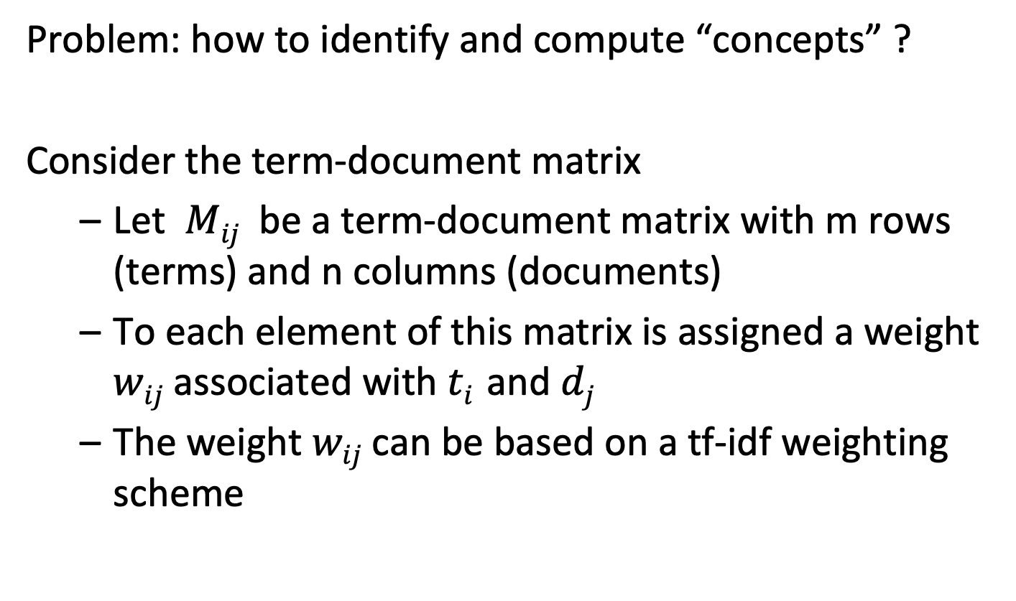
Basic Definitions
Problem: how to identify and compute “concepts” ?
Consider the term-document matrix
Let $Mij$ be a term-document matrix with m rows (terms) and n columns (documents)
To each element of this matrix is assigned a weight $wij$ associated with $ti$ and $dj$
The weight $wij$ can be based on a tf-idf weighting scheme
Notes:
The challenge is to find a method that identifies and characterizes important concepts in document collections. One approach would be to perform this task manually, e.g. by using a predefined ontology and let users annotate documents using terms of the ontology. This is an approach that his been used in libraries, but is labour intensive. Thus we will now present a method that performs the task of concept identification and document classification by concepts automatically. Starting point for the method is the term-document matrix that we have introduced for vector space retrieval with weights based on a tf-idf weighting scheme.

Slide 11
Computing the Ranking Using M
Scalar product
m
M^{t} . q
M^{t}
q
query . doc1
doc1
query . doc2 ...
doc2
doc3
m
query
n
doc4
doc5
query . doc6
doc6
Notes:
We can interpret the process of producing a retrieval result in vector space retrieval as a matrix operation. This is illustrated in this figure. The ranking results from computing the product of a query vector q with the term-document matrix M. We assume that all columns in M and q are normalized to 1.

Slide 12
In vector space retrieval each row of the matrix M corresponds to
A document
A concept
A query
A term

Slide 13

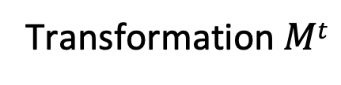
Identifying Top Concepts
Key Idea: extract the essential features of $Mt$ and approximate it by the most important ones
“Top concept”
Transformation $Mt$
Unit ball
Transformed ball
Notes:
One way to understand of how concepts can be extracted from a document collection is to consider the effect of the term-document matrix on data. If we apply this matrix to a (high-dimensional) unit ball it will distort this ball into an ellipsoid. This ellipsoid will have one direction with the strongest distortion. We may think of this direction as corresponding to a particularly important concept in the document collection.

Slide 14
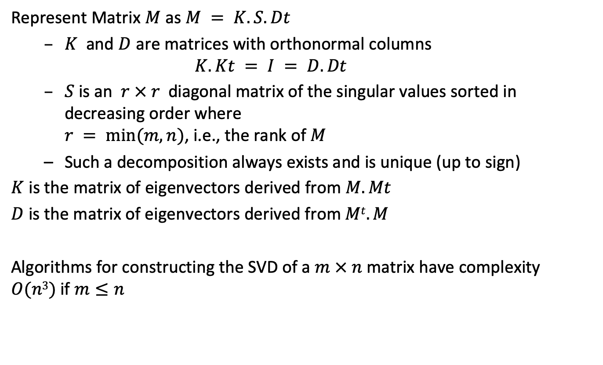
Singular Value Decomposition (SVD)
Represent Matrix $M$ as $M = K.S.Dt$
$K$ and $D$ are matrices with orthonormal columns
$$K.Kt = I = D.Dt$$
$S$ is an $r × r$diagonal matrix of the singular values sorted in decreasing order where $r = min⁡(m, n)$, i.e., the rank of $M$
Such a decomposition always exists and is unique (up to sign)
$K$ is the matrix of eigenvectors derived from $M.Mt$
$D$ is the matrix of eigenvectors derived from $Mt.M$
Algorithms for constructing the SVD of a $m × n$matrix have complexity $O(n3)$if $m≤n$
Notes:
To identify the principal direction of distortion induced by the matrix transformation, a standard tool from linear algebra can be used, the singular value decomposition (SVD). SVD decomposes a matrix into the product of three matrices. The middle matrix S is a diagonal matrix, where the elements of this matrix are the singular values of the matrix M.

Slide 15

Construction of SVD
$K$ is the matrix of eigenvectors derived from $M.Mt$
$D$ is the matrix of eigenvectors derived from $Mt.M$
Algorithms for constructing the SVD of a $m × n$matrix have complexity $O(n3)$if $m≤n$
Notes:
Formally the SVD can be computed by constructing Eigenvectors of matrices derived from the original matrix M. This computation can be performed in time O(n^3). Note that the time complexity is considerable for large matrices, which makes the approach computationally expensive. There exist however also approximation and randomized techniques to perform this decomposition more efficiently (e.g. https://research.fb.com/blog/2014/09/fast-randomized-svd/).

Slide 16
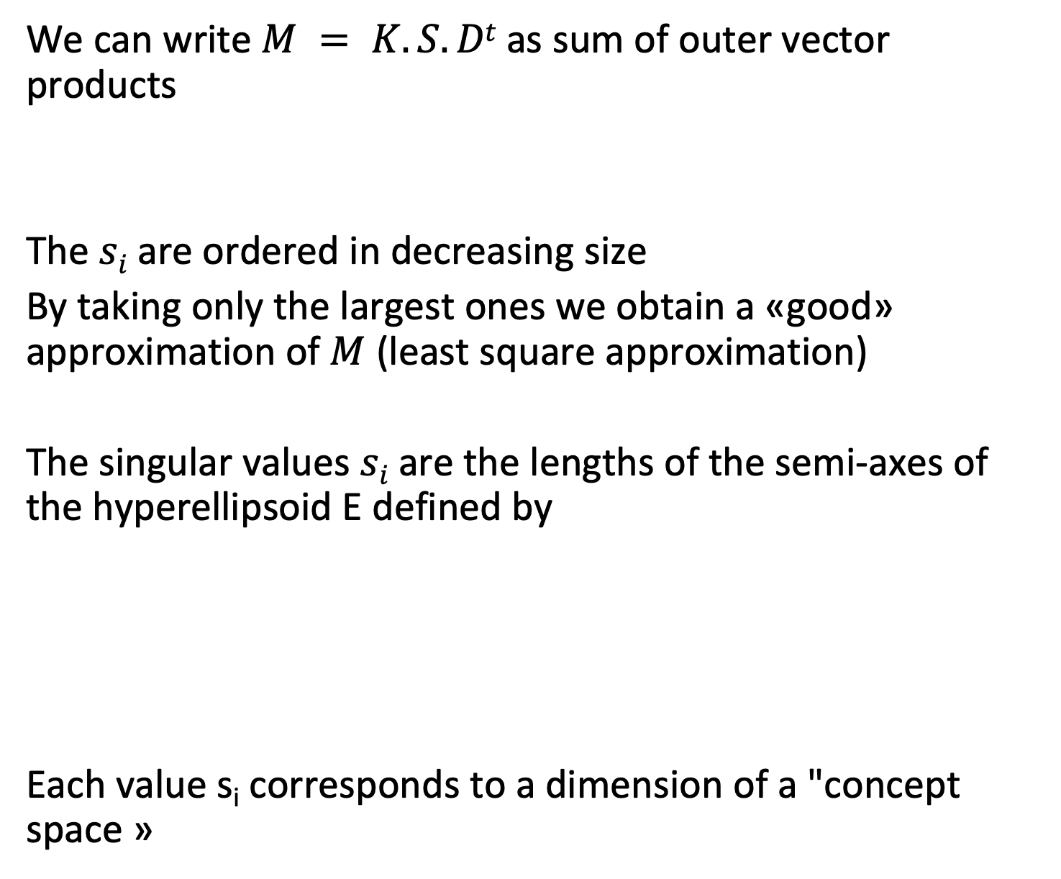
Interpretation of SVD
We can write $M = K.S.Dt$as sum of outer vector products
The $si$ are ordered in decreasing size
By taking only the largest ones we obtain a «good» approximation of $M$ (least square approximation)
The singular values $si$are the lengths of the semi-axes of the hyperellipsoid E defined by
Each value s_{i} corresponds to a dimension of a "concept space »
Notes:
One way to understand of how the SVD extracts the important concepts from the term-document matrix is the following: the decomposition can be used to rewrite the original matrix as the sum of components that are weighted by the singular values. Thus we can obtain approximations of the matrix by only considering the larger singular values. The SVD after eliminating less important dimensions (smaller singular values) can be interpreted as a least square approximation to the original matrix. The symbol ⊗ denotes the outer product of two vectors, d_{i} is the i-th row of D. The outer product of vectors u =. (u_1,…,u_m) and v = (v_1,…,v_n) is given by the mxn matrix m with entries m_ij = u_i v_j.
The singular values have also a geometric interpretation, as they tell us how a unit ball (||x||=1) is distorted when the linear transformation defined by the matrix M is applied to it. We can interpret the axes of the hyperellipsoid E as the dimensions of the concept space.

Slide 17
Illustration of SVD
n
r
r
n
m
M
=
K
•
S
•
D^{t}
r
Vectors represent
documents in concept space
Vectors represent
terms in concept space
m x n
m x r
r x r
r x n
Assuming m ≤ n
Notes:
This figure illustrates the structure of the matrices generated by the SVD. In general, m <= n, i.e., the number of documents is larger than the size of the vocabulary. The rows in K can then be interpreted as the representation of terms in the concept space, and the rows in D as the representation of documents in the concept space.

Slide 18
Illustration of SVD – Another Perspective
n
r
r
n
m
M
=
K
•
S
•
D^{t}
r
Vectors represent
concepts in document space
Vectors represent
concepts in term space
m x n
m x r
r x r
r x n
Assuming m ≤ n
Notes:
We can also see of how the concepts are represented by terms respectively documents. In particular, each concepts is now described as a vector of weighted terms.

Slide 19
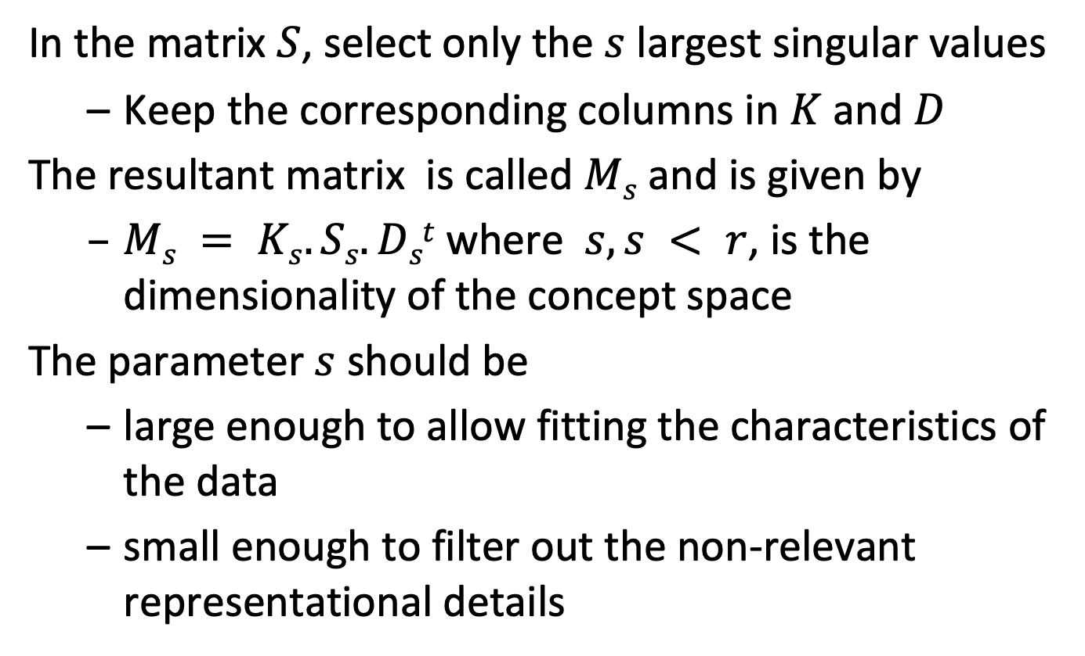
Latent Semantic Indexing (LSI)
In the matrix $S$, select only the $s$ largest singular values
Keep the corresponding columns in $K$ and $D$
The resultant matrix is called $Ms$ and is given by
$Ms = Ks.Ss.Dst$where $s, s < r$, is the dimensionality of the concept space
The parameter $s$ should be
large enough to allow fitting the characteristics of the data
small enough to filter out the non-relevant representational details
Notes:
Using the singular value decomposition, we can now derive an "approximation" of M by retaining only the s largest singular values in matrix S. The choice of s determines on how many of the "important concepts" the ranking will be based on. The assumption is that concepts with small singular value in S are rather to be considered as "noise" and thus can be dismissed. The resulting method is called Latent Semantic Indexing (LSI).

Slide 20
Illustration of Latent Semantic Indexing
n
s
n
m
M_{s}
=
K_{s}
•
S_{s}
•
D_{s}^{t}
s
Document vectors
Term vectors
m x n
m x s
s x s
s x n
Notes:
This figure illustrates the structure of the matrices after reducing the dimensionality of the concept space to s, when only the first s singular values are kept for the computation of the ranking. The rows in matrix K_{s} correspond to term vectors, whereas the columns in matrix D_{s}^{t} correspond to document vectors. By using the cosine similarity measure between columns of matrix D_{s}^{t} a similarity measure of documents can be computed.

Slide 21
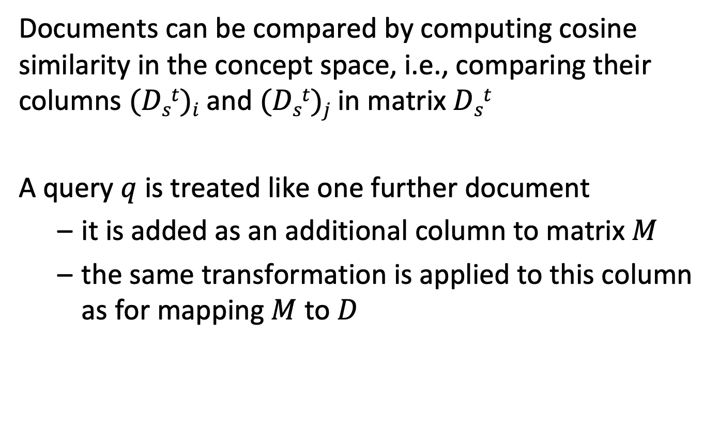
Answering Queries
Documents can be compared by computing cosine similarity in the concept space, i.e., comparing their columns $(Dst)i$and $(Dst)j$in matrix $Dst$
A query $q$ is treated like one further document
it is added as an additional column to matrix $M$
the same transformation is applied to this column as for mapping $M$ to $D$
Notes:
After performing the SVD, the similarity of different documents can be determined by computing the cosine similarity measure among their representation in the concept space (the columns of matrix D_{s}^{t}). Queries are considered like documents that are added to the document collection. For answering queries, the query is treated like a document, and its representation in the concept space is used to compute the similarity to documents.

Slide 22
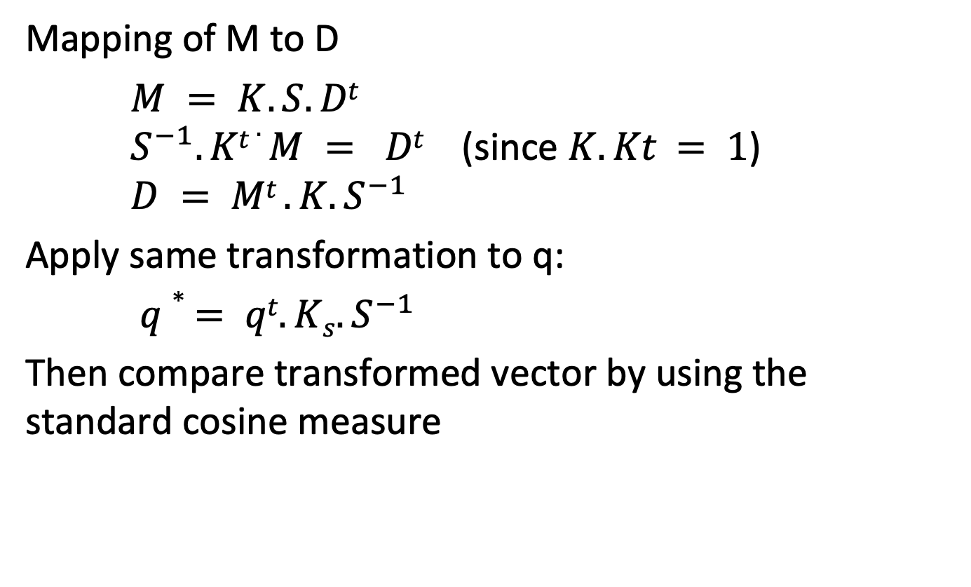
Mapping Queries
Mapping of M to D
$M = K.S.Dt$ $S^{−1}.Kt .M = Dt$ (since $K.Kt = 1$) $D = Mt .K.S^{−1}$
Apply same transformation to q:
$q∗ = qt.Ks.S^{−1}$
Then compare transformed vector by using the standard cosine measure
Notes:
The transformation of queries into concept vectors works as follows: when a new column (the query) is added to M, we have to apply the same transformation to this new column, as to the other columns of M, in order to produce the corresponding column in the matrix D_{s}^{t}, representing documents in the concept space. We exploit the fact that K_{s} ^{t}.K_{s} =1.
Since M_{s} = K_{s} .S_{s} .D_{s}^{t} we obtain S_{s} ^{–1} .K_{s} ^{t} .M_{s} = D_{s}^{t} or D_{s}= M_{s} ^{t} .K_{s} .S_{s} ^{–1 .}
This transformation is applied to the query vector q to obtain a query vector q* in the concept space. After that step, the similarity of the query to the documents in the concept space can be computed. ((D_{s}^{t})_{i} denotes the i-th column of matrix D_{s}^{t})

Slide 23
Illustration of LSI Querying
n
s
q^{t}
n
q*
m
M_{s}
=
K_{s}
•
S_{s}
•
D_{s}^{t}
s
Document vectors
Term vectors
m x n
m x s
s x s
s x n
Notes:
This figure illustrates of how a query vector is treated like an additional document vector.

Slide 24
Example: Documents
B1 A Course on Integral Equations
B2 Attractors for Semigroups and Evolution Equations
B3 Automatic Differentiation of Algorithms: Theory, Implementation, and Application
B4 Geometrical Aspects of Partial Differential Equations
B5 Ideals, Varieties, and Algorithms: An Introduction to Computational Algebraic Geometry and Commutative Algebra
B6 Introduction to Hamiltonian Dynamical Systems and the N-Body Problem
B7 Knapsack Problems: Algorithms and Computer Implementations
B8 Methods of Solving Singular Systems of Ordinary Differential Equations
B9 Nonlinear Systems
B10 Ordinary Differential Equations
B11 Oscillation Theory for Neutral Differential Equations with Delay
B12 Oscillation Theory of Delay Differential Equations
B13 Pseudodifferential Operators and Nonlinear Partial Differential Equations
B14 Sinc Methods for Quadrature and Differential Equations
B15 Stability of Stochastic Differential Equations with Respect to Semi-Martingales
B16 The Boundary Integral Approach to Static and Dynamic Contact Problems
B17 The Double Mellin-Barnes Type Integrals and Their Applications to Convolution Theory
Notes:
This is an example of a (simple) document collection that we will use in the following as running example.

Slide 25
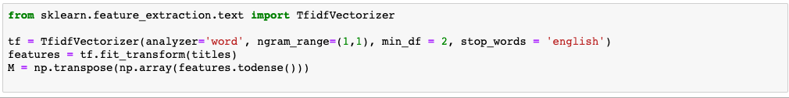
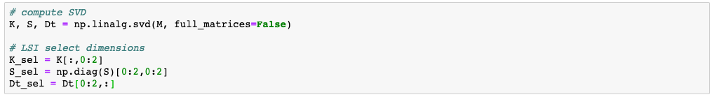
Implementation in Python
Notes:
Given Python libraries that compute the SVD, we can implement the LSI method directly using the definitions and based on the term-document matrix that we have already computed for the vector space retrieval model.

Slide 26
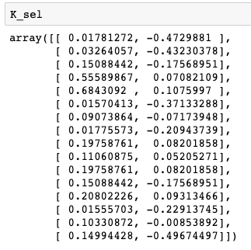
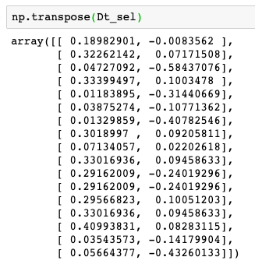

Results (s=2)
Notes:
Her we inspect the resulting matrices, when selecting s=2 dimensions.

Slide 27
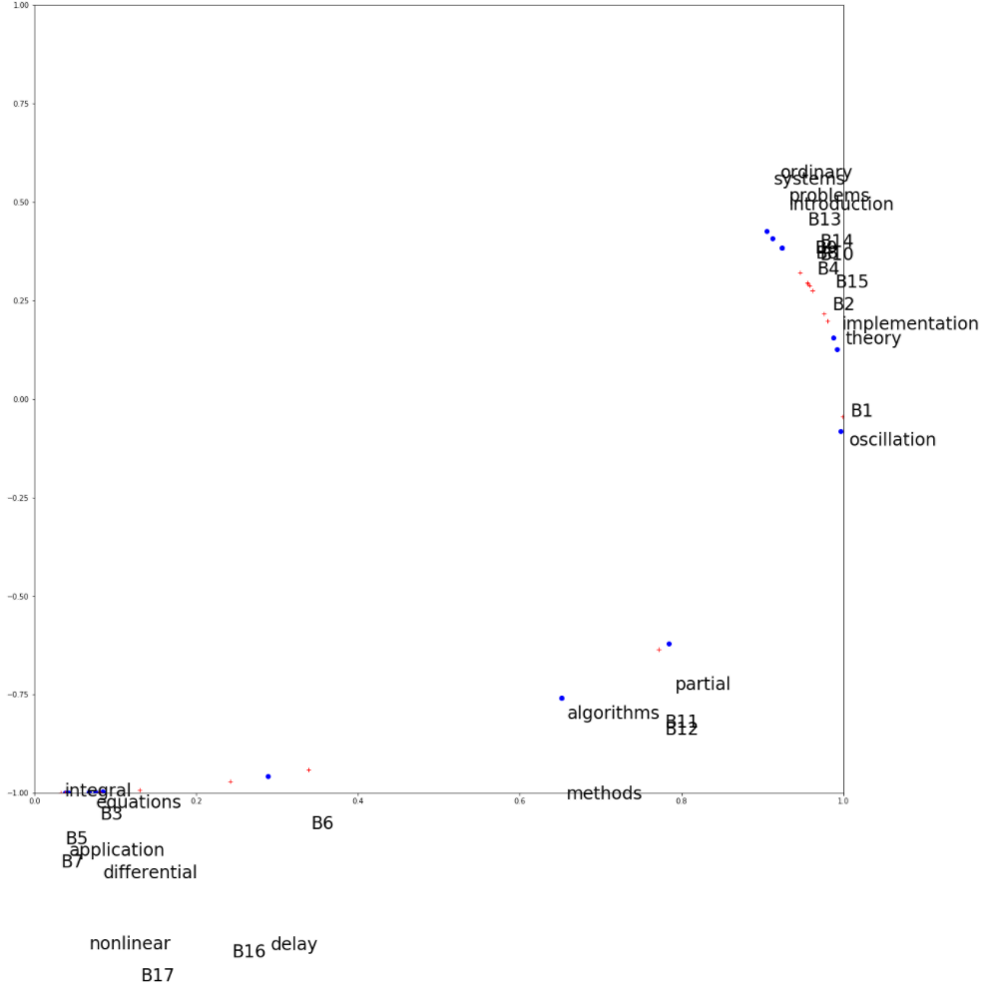
Plot of Terms and Documents in 2-d Concept Space
Notes:
Since in our example the concept space has two dimensions, we can plot both the documents and the terms in this 2-dimensional space. It is interesting to observe of how semantically "close" terms and documents cluster in the same regions. This illustrates very well the potential of latent semantic indexing in revealing the « essential concepts » in document collections.

Slide 28
Applying SVD to a term-document matrix M. Each concept is represented in K
as a singular value
as a linear combination of terms of the vocabulary
as a linear combination of documents in the document collection
as a least squares approximation of the matrix M

Slide 29
The number of term vectors in the matrix K_{s} used for LSI
Is smaller than the number of rows in the matrix M
Is the same as the number of rows in the matrix M
Is larger than the number of rows in the matrix M

Slide 30
A query transformed into the concept space for LSI has …
s components (number of singular values)
m components (size of vocabulary)
n components (number of documents)

Slide 31
Discussion of Latent Semantic Indexing
Latent semantic indexing provides an interesting conceptualization of the IR problem
Advantages
It allows reducing the complexity of the underlying concept representation
Facilitates interfacing with the user
Disadvantages
Computationally expensive
Poor statistical explanation
Notes:
LSI has been a fundamental advance in the development of informational retrieval. However, it also suffers from conceptual problems.
For example, least squares approximation is based on the assumption that term frequencies are normally distributed. This is not consistent with the observation that term frequencies are power-law distributed.

Slide 32
Alternative Techniques
Probabilistic Latent Semantic Analysis
Based on Bayesian Networks
Latent Dirichlet Allocation
Based on Dirichlet Distribution
State-of-the-art method for concept extraction
Same objective of creating a lower-dimensional concept space based on the term-document matrix
Better explained mathematical foundation
Better experimental results
Notes:
LSI has triggered the search for different alternative approaches for better capturing the semantic properties of text in information retrieval.
One recent successful approach is LDA, based on the use of Dirichlet distributions. Like LSI it generates a concept space, where concepts are represented as term vectors. The method has better theoretical foundations and empirically it produces better results. It is nowadays considered as a golden standard. The approach is mathematically more involved than LSI, and therefore we will not be able to develop this method in this lecture.

Slide 33
1.3.2 Latent Dirichlet Allocation (LDA)
Idea: assume a document collection is (randomly) generated from a known set of topics (probabilistic generative model)
money
money
bank
loan
DOCUMENT 1: money¹ bank¹ bank¹ loan¹ river² stream² bank¹ money¹ river² bank¹ money¹ bank¹ loan¹ money¹ stream² bank¹ money¹ bank¹ bank¹ loan¹ river² stream² bank¹ money¹ river² bank¹ money¹ bank¹ loan¹ bank¹ money¹ stream²
.8
loan
bank
bank
Topic is a mixture of words
loan
.2
Document is a mixture of topics
TOPIC 1
.3
river
bank
DOCUMENT 2: river² stream² bank² stream² bank² money¹ loan¹ river² stream² loan¹ bank² river² bank² bank¹ stream² river² loan¹ bank² stream² bank² money¹ loan¹ river² stream² bank² stream² bank² money¹ river² stream² loan¹ bank² river² bank² money¹ bank¹ stream² river² bank² stream² bank² money¹
stream
river
.7
river
bank
stream
TOPIC 2
Notes:
This illustration shows the basic idea underlying LDA: it is assumed that there exist topics that are represented as mixtures of words. In the example we see words that are related to two meanings of “bank”, the financial institution and the river bank, and are represented by different related works. Then, documents are assumed to be generated from a mixture of topics, where the mixture is determined by weights, as indicated in the figure. As a result, each document contains terms form its associated topics in the right proportion.
Like the probabilistic language model used in information retrieval, this approach us an example of a probabilistic generative model.

Slide 34
Document Generation using a Probabilistic Process
For each document, choose a mixture of topics
For every word position, sample a topic from the topic mixture
For every word position, sample a word from the chosen topic
TOPIC MIXTURE
TOPIC
WORD
TOPIC
WORD
...
...
Notes:
Given the topic model, we obtain a probabilistic process for generating documents.

Slide 35
LDA: Topic Identification
Approach: Inverting the process: given a document collection, reconstruct the topic model
?
DOCUMENT 1: money? bank? bank? loan? river? stream? bank? money? river? bank? money? bank? loan? money? stream? bank? money? bank? bank? loan? river? stream? bank? money? river? bank? money? bank? loan? bank? money? stream?
TOPIC 1
?
DOCUMENT 2: river? stream? bank? stream? bank? money? loan? river? stream? loan? bank? river? bank? bank? stream? river? loan? bank? stream? bank? money? loan? river? stream? bank? stream? bank? money? river? stream? loan? bank? river? bank? money? bank? stream? river? bank? stream? bank? money?
?
TOPIC 2
Notes:
While it is straightforward to generate documents, once the probabilistic topic model is given, deriving a topic model for a given document collection is a hard problem. To solve this problem, a probabilistic topic model needs to be derived, that is likely to generate the document collection under consideration.

Slide 36
Latent Dirichlet Allocation
Topics are interpretable unlike the arbitrary dimensions of LSI
Topic and word distributions are Dirichlet distributions
Construction of topic model is mathematically involved, but computationally feasible
Considered as a state-of-the art method for topic identification
Notes:
We do not present the details of LDA here, as the method is mathematically fairly involved. However, it is important to note that it is considered today as a state-of-the-art method of topic detection.

Slide 37
Use of Topic Models
Unsupervised Learning of topics
Understanding main topics of a topic collection
Organizing the document collection
Use for document retrieval: use topic vectors instead of term vectors to represent documents and queries
Document classification (Supervised Learning): use topics as features
Notes:
Topic models provide a representation of documents at a conceptual level. Therefore, they are applied in many different contexts, including document retrieval and classification.

Slide 38
Summary
0
1
0
1
0
0
0
0
0
1
0
0
1
0
0
1
0
0
0
0
1
0
1
0
0
0
0
1
0
0
0
0
0
1
1
1
0
0
1
0
1
0
0
0
1
0
0
0
1
0
0
1
1
1
0
1
0
0
0
0
0
1
1
0
0
1
0
0
1
VS model maps documents to
sparse term vectors
(dimension = term in vocabulary)
Topic model maps documents to
dense vectors (dimension = topic)
Each topic corresponds to a distribution over terms
Notes:
This illustration summarizes the connection between the vector space model, which we introduced for information retrieval and topic models that produce low-dimensional (dense) representation of documents.

